Slide 1
Classification of Mobile Apps on Apple Store Using Clustering
By : Shaimaa Osman Zaky
Supervised :Dr Doaa Mahmoud

Slide 2
Agenda
Objective of project
Dataset
Data visualization
Preprocessing
Modeling

Slide 3
Objective of project
With millions of apps around nowadays, the following data set has become very key to getting top trending apps in the iOS app store. This data set contains more than 7000 Apple iOS mobile application details.
Apply Data visualization , Preprocessing for datasets ,and will use clustering model to split data to some of groups according this features .
we will answer about this question from data
1) How do you visualize the price distribution of paid apps ?
2) How does the price distribution get affected by category ?
3) What about paid apps Vs Free apps ?
4) Are paid apps good enough ?
5)As the size of the app increases do they get pricier ?
6)How are the apps distributed category wise ? Can we split by paid category ?

Slide 4
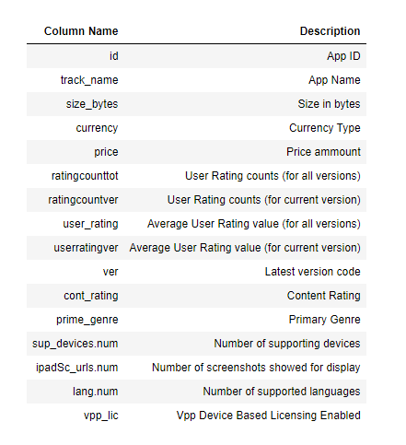
Dataset
Data description
Mobile App Store (7200 apps)
data has float64(for 3 columns) ,
int64(8 columns), object(5 columns)
shape of data (7197, 16)
Not found null data

Slide 5
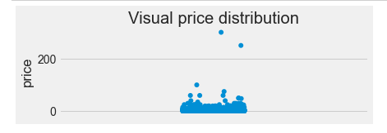
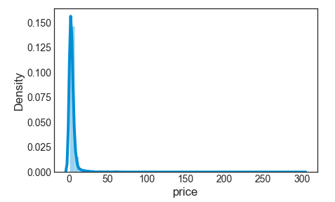
Data visualization
# How do you visualize price distribution of paid apps ? Visualize for paid apps data
Sum of free apps ==4056 Sum of paid apps ==3141

Slide 6
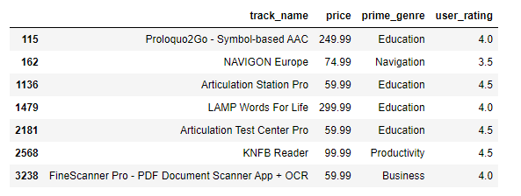
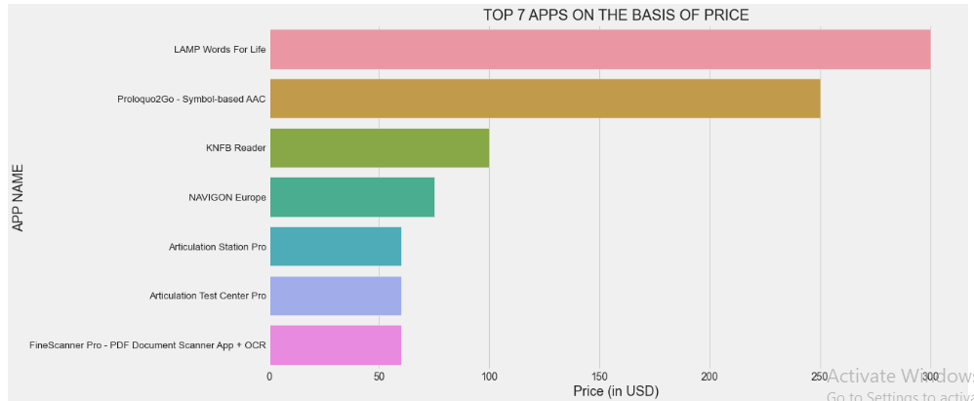
Data visualization
7 Top apps with price, prime_genre and user rating

Slide 7
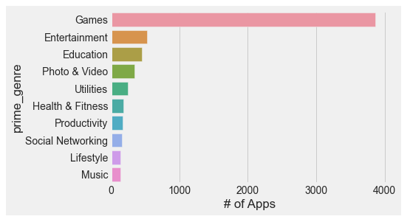
Data visualization
How does the price distribution get affected by category ?
Top app category is Games # is 3862 and Entertainment # is 535.
Categories and number of apps in each category.

Slide 8
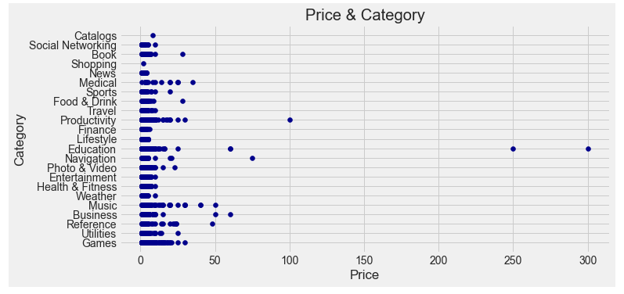
Data visualization

Slide 9
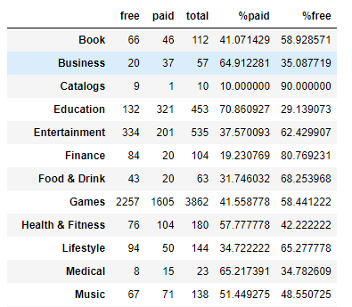
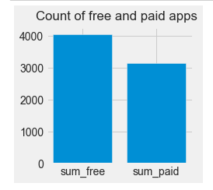
Data visualization
What about paid apps Vs Free apps ?
Count of paid apps less than count of free apps
In general # of Free apps greater than # of paid apps

Slide 10
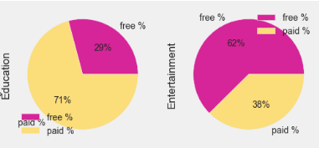
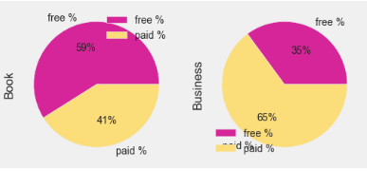
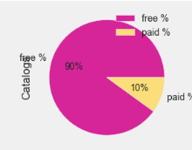
Data visualization
Cataloge has Higher # of Free-Apps
Education has Higher # of Paid-Apps

Slide 11

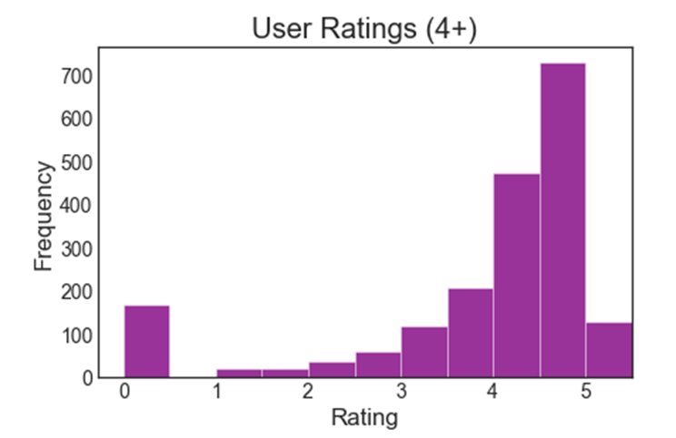
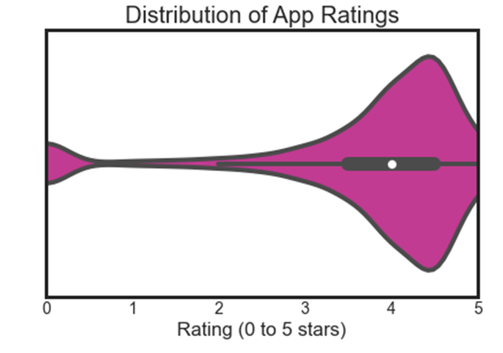
Data visualization
Are paid apps good enough ?
Most rated & highest total rating for all version app:
Distribution of App Ratings

Slide 12
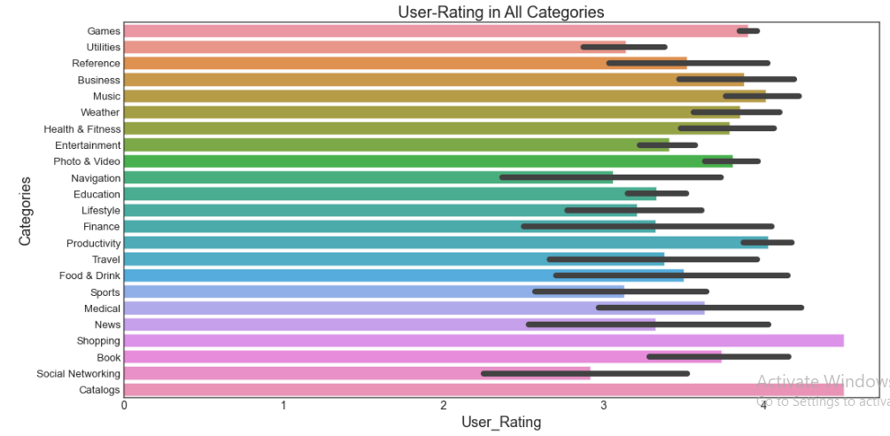
Data visualization
Rating of paid Apps between 3.5 - 5
maybe say is good paid apps
higher Rating in Shopping & Catalogs

Slide 13
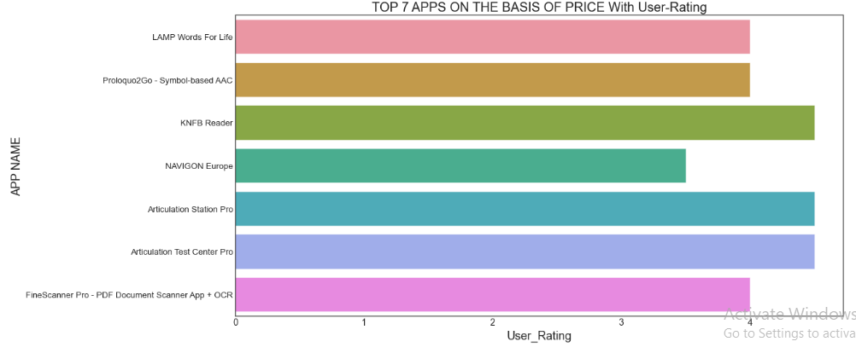
Data visualization
apps has high price also has high user-rating according for that paid apps is good enough

Slide 14
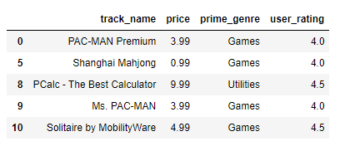
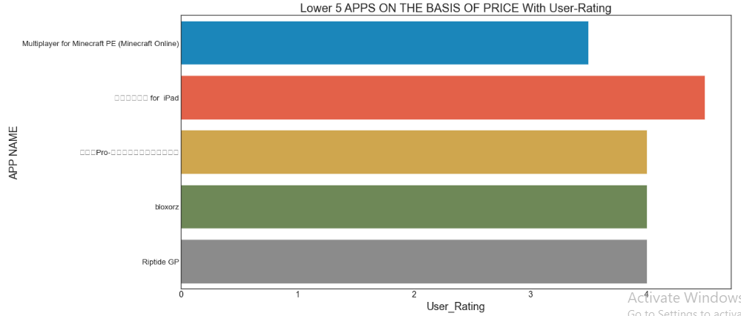
Data visualization
lower_apps in price also has high user-rating so paid apps is good

Slide 15
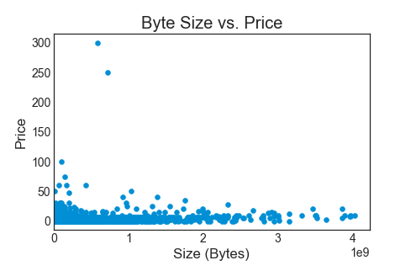
Data visualization
As the size of the app increases do they get pricier ?
size of App not correlated with price
we show that if size is big ,price is low
the value of an app to the user isn't necessarily related to its size.

Slide 16
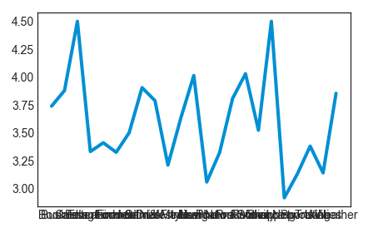
Data visualization
How are the apps distributed category wise ? Can we split by paid category ?
user_rating for paid apps

Slide 17
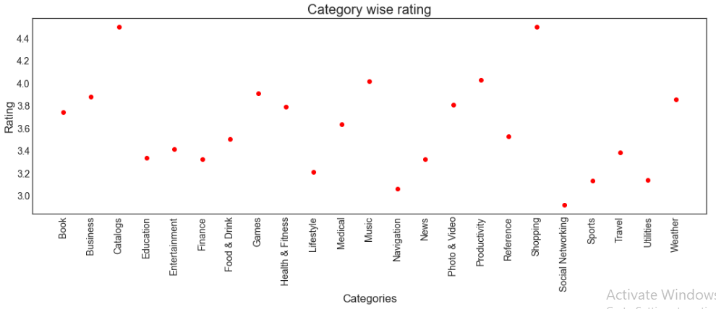
Data visualization
High Rating with catalogs , shopping
Low rating in social networking for paid apps

Slide 18
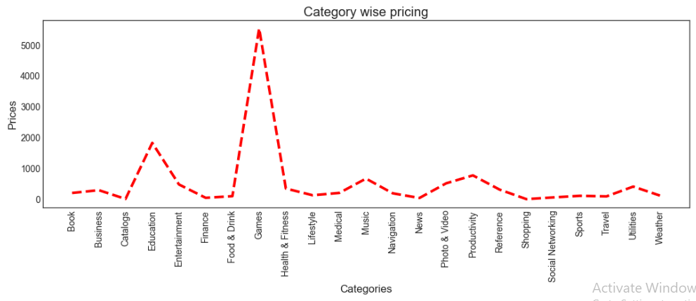
Data visualization
Category wise pricing for paid apps not all data

Slide 19
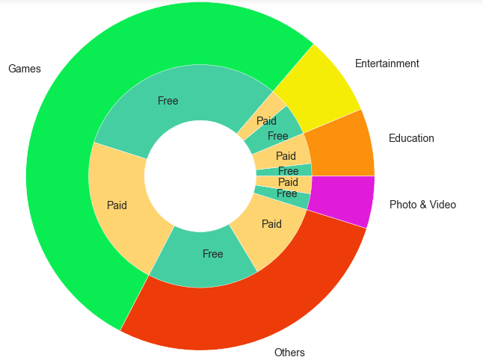
Data visualization

Slide 20
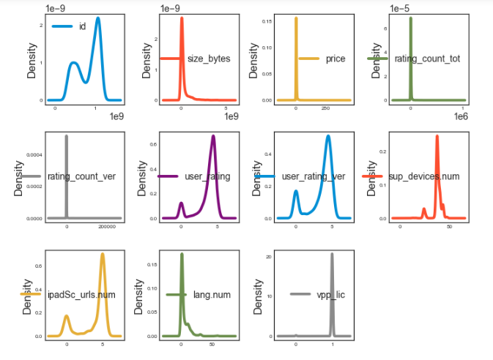
Data visualization
Density for paid apps

Slide 21
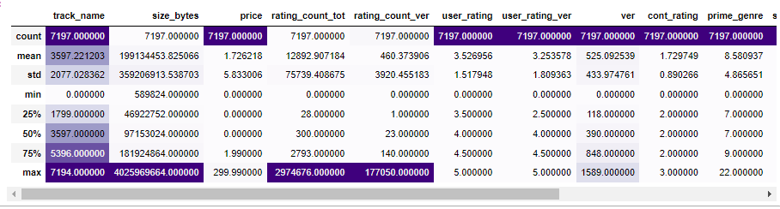
Feature Engineering
Encoding for object columns
Drop for some of non important columns
we found variation in data as standard deviation is different
some of columns has big outliers

Slide 22
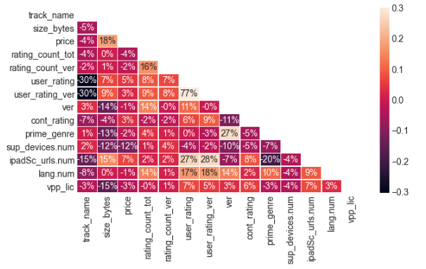
Preprocessing - Correlation matrix
Correlation between user_rating_var , user_rating is high 77%
ipadSc_urls.num , user_rating is 27%
ipadSc_urls.num , user_rating_var is 28%

Slide 23
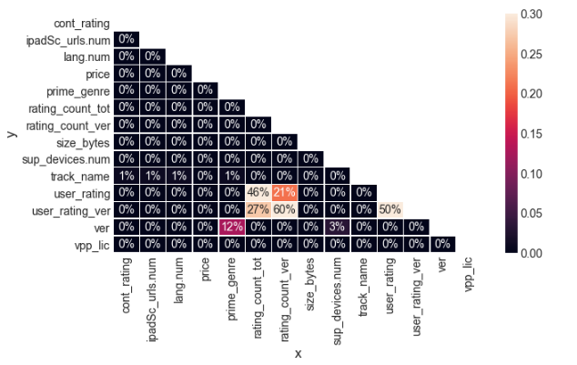
Preprocessing - Correlation matrix
PPS(Predictive Power Score)Non Linear Data
Correlation matrix is better than pps in this case

Slide 24
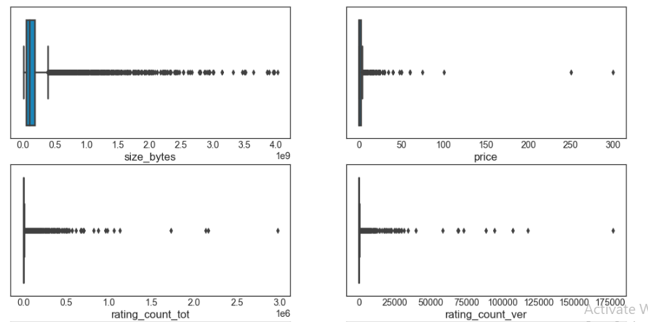
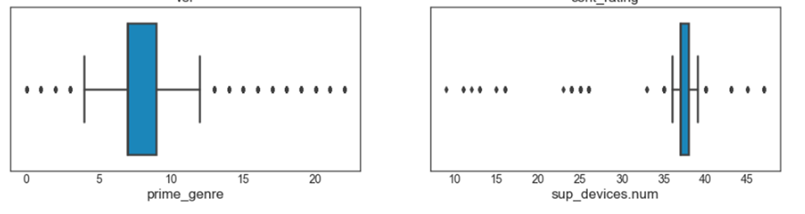
Preprocessing
Some of columns has outliers
We used robust scaler to optimze data

Slide 25
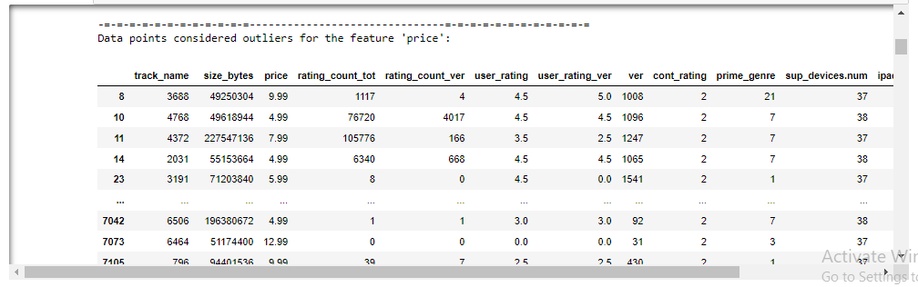
Preprocessing - Outliers
Calculate datapoint outliers for all features by
Use the interquartile range to calculate an outlier step (1.5 times the interquartile range)
step = (Q3 - Q1) * 1.5

Slide 26
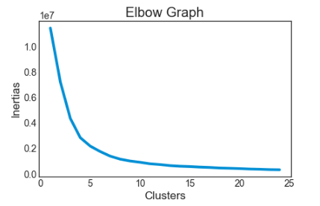
Modeling - Clustering Model
Elbow Graph for Inertias & # of clusters
Elbow graph to show less inertias as accuracy will be increasing

Slide 27
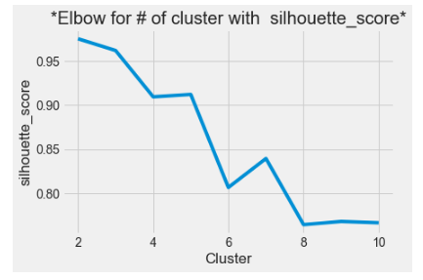
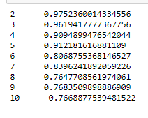
Modeling - Clustering Model
Elbow for # of cluster with silhouette_score

Slide 28
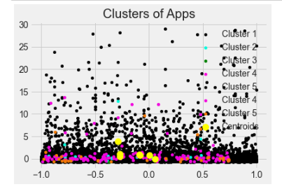
Modeling - Clustering Model Visualising the Clusters & Future Work
after clustering we have 7 clusters from Apps according all features
future work use this cluster to apply classification model

Slide 29
References Data Set https://www.kaggle.com/ramamet4/app-store-apple-data-set-10k-apps https://www.scirp.org/journal/paperinformation.aspx?paperid=99525 Contact Email shamiaosman4321@gmail.com Linkedin https://www.linkedin.com/in/shaimaa-osman/

Slide 30
Thank you

